Slide 1

Building Gateway Services
Graham Robinson
John Patterson
• 4th September 2017

Slide 2
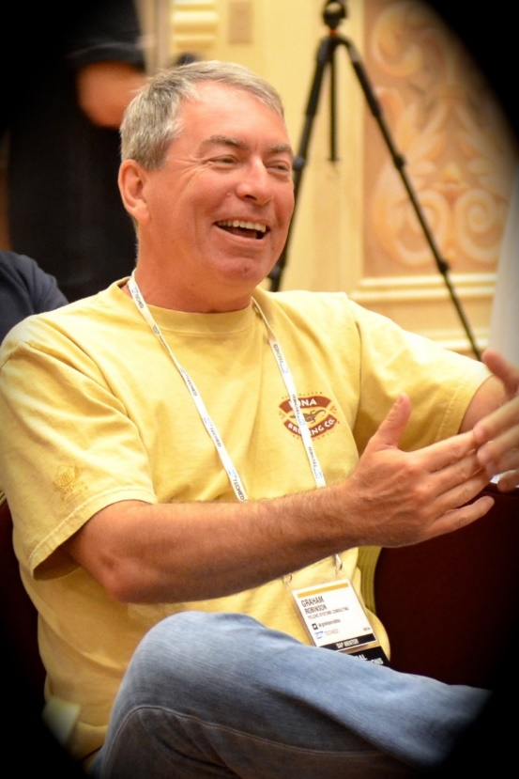


Introduction
@grahamrobbo
@jasper_07

Slide 3
Agenda
Some Warnings
CDS
Service Design
Code patterns for reusability

Slide 4
Agenda
Some Warnings
CDS
Service Design
Code patterns for reusability

Slide 5
Warning – This is not For Beginners

Slide 6
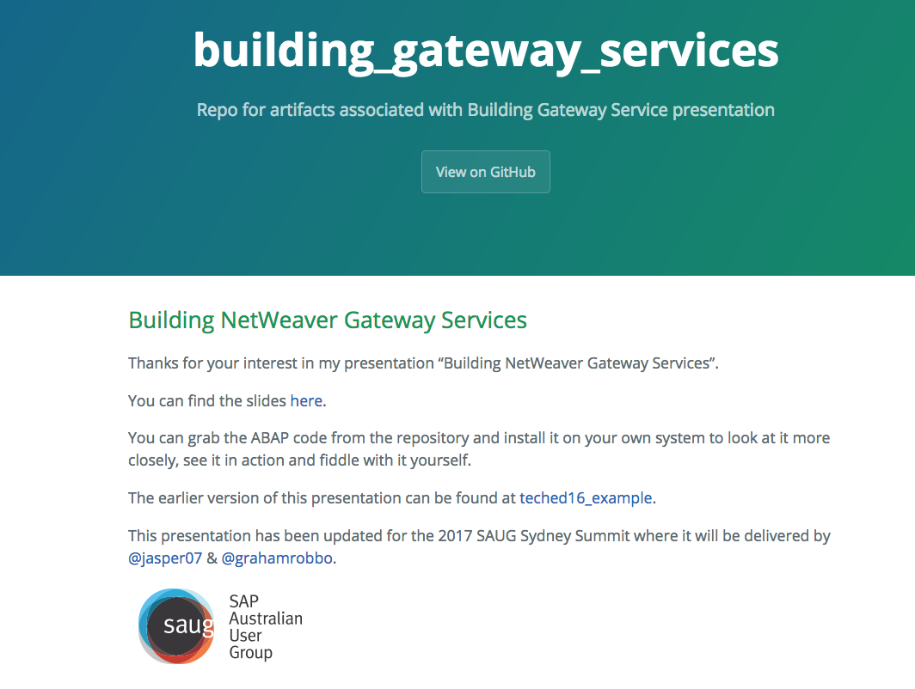
Warning - Homework
https://grahamrobbo.github.io/building_gateway_services/
To install you will also need abapGit
https://abapGit.org

Slide 7
Warning – focus on consumption

Slide 8
Warning – we do not have all the answers

Slide 9
Agenda
Some Warnings
CDS
Service Design
Code patterns for reusability

Slide 10



ABAP Core Data Services (CDS)
Available
From 7.40 SP05
Common data model
Semantically rich
Runs on any database
OData service enabled
Capture business intent
Reduce complexity
Views on views
Analytics infused
Improved programming model
For all applications domains
Code pushdown
Rich set of built-in functions

Slide 11
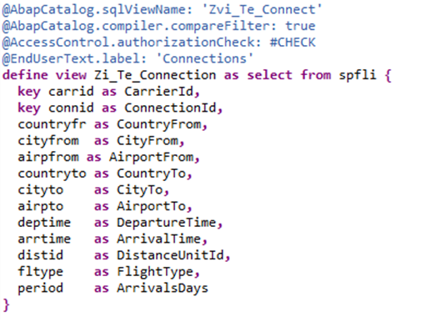
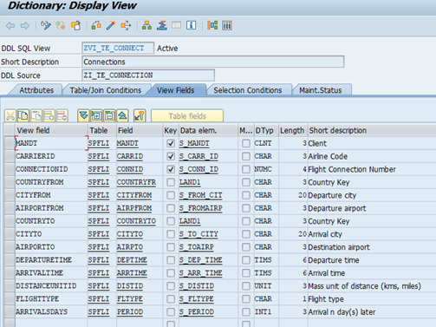
Basic View

Slide 12
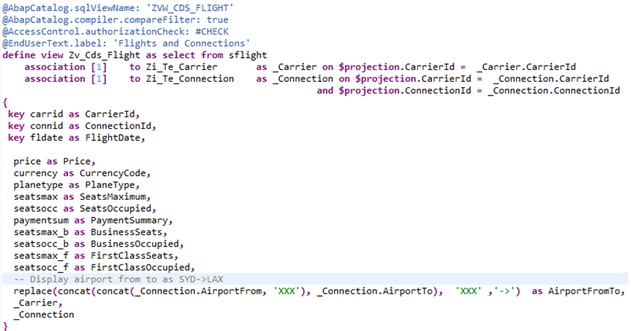
Associations

Slide 13
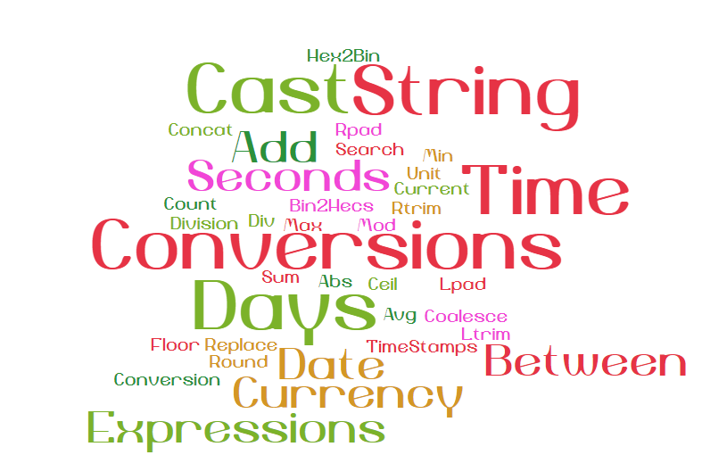
Supported Functions and Expressions

Slide 14
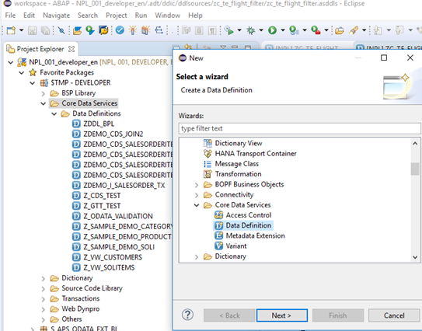
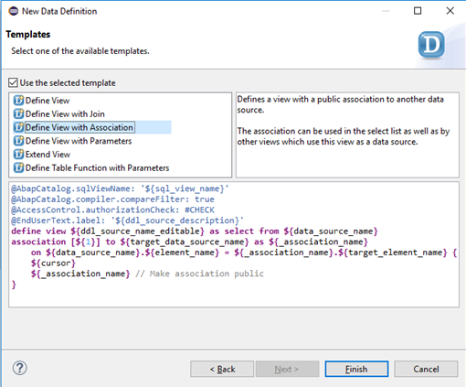
Create in ABAP in Eclipse (AiE)

Slide 15
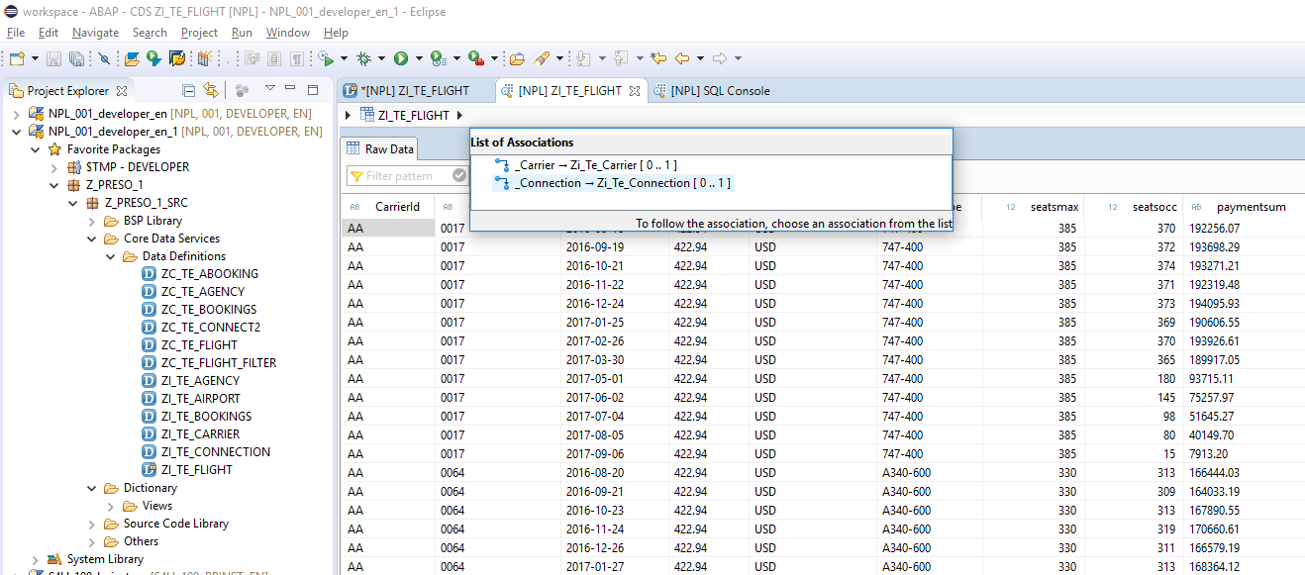
Data Preview

Slide 16
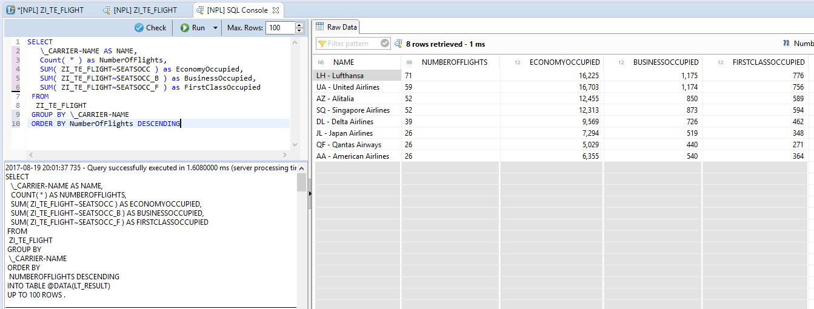
SQL Console
Powerful
Stuff

Slide 17
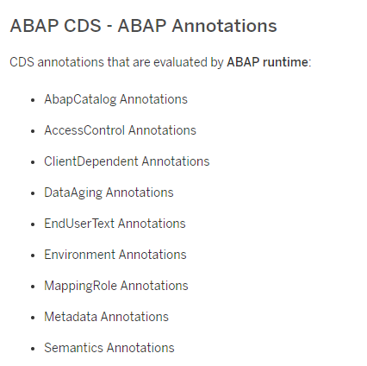
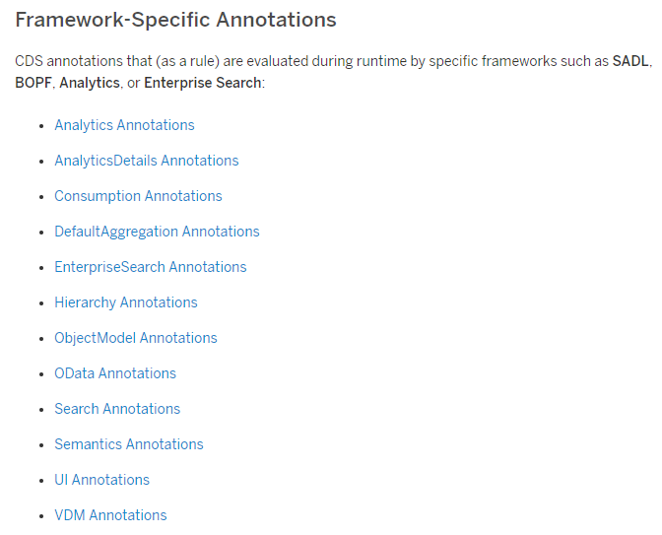
Annotations
SAP Help: CDS Annotations

Slide 18
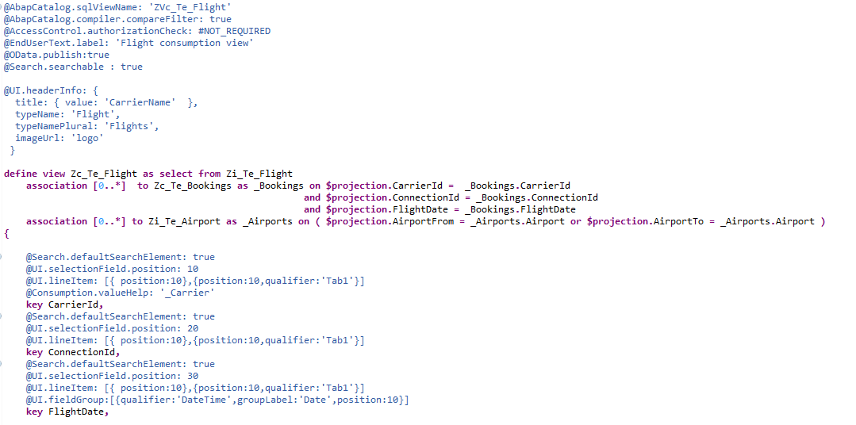
Annotations Example
Access Control
OData
Search
UI

Slide 19
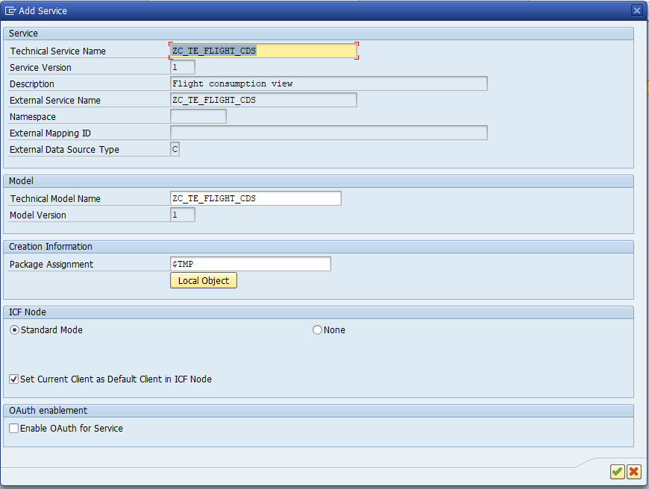
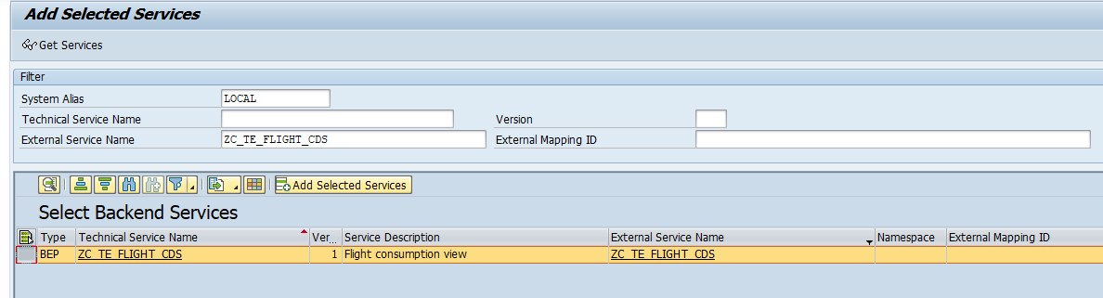
Activate OData Service
Transaction /IWFND/MAINT_SERVICE

Slide 20
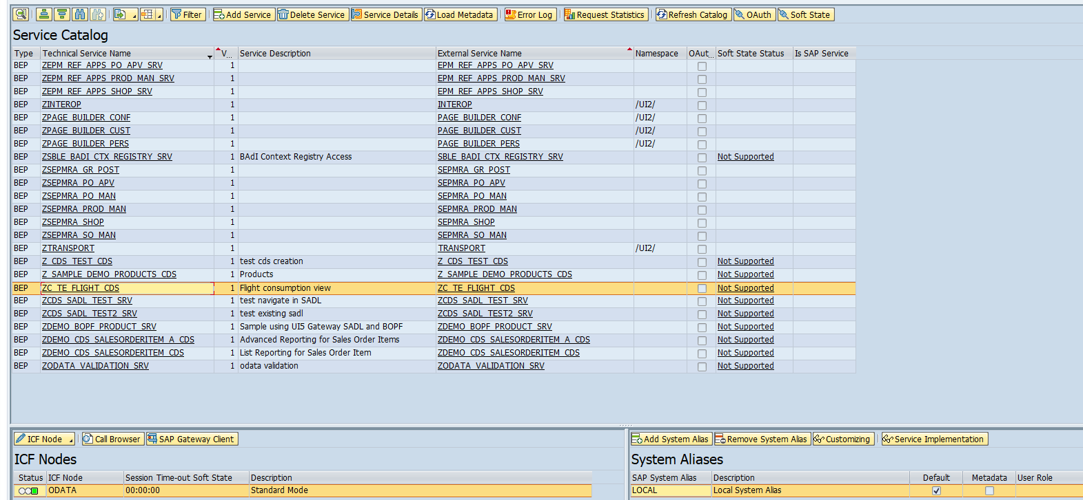
Activate OData Service (2)

Slide 21
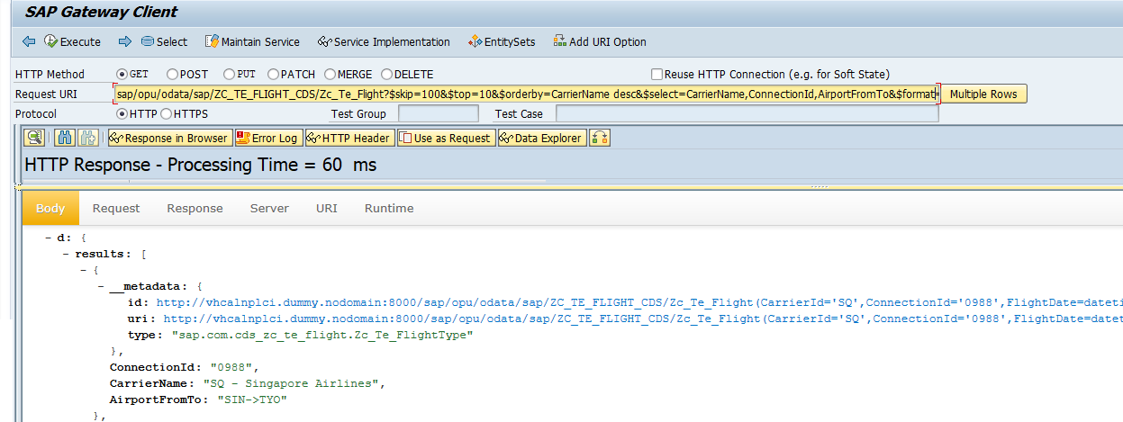
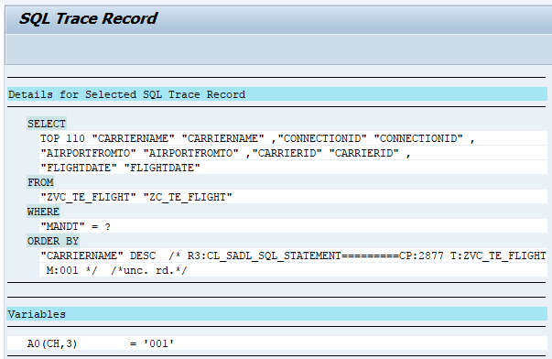
Test Service

Slide 22
Agenda
Some Warnings
CDS
Service Design
Code patterns for reusability

Slide 23
Service Design Principles
Design for Consumers
Think oData i.e. Entities, Associations, etc.
Leave SAP domain knowledge at the door
REST API’s should be self-describing
Function Imports should be for special cases

Slide 24
General Theory of API Design

Slide 25
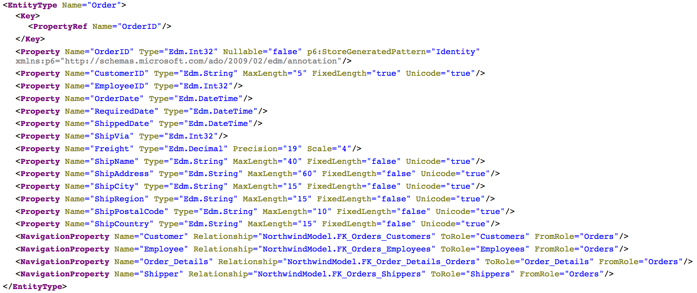
Consumer View of API
Source: http://services.odata.org/northwind/northwind.svc/$metadata

Slide 26
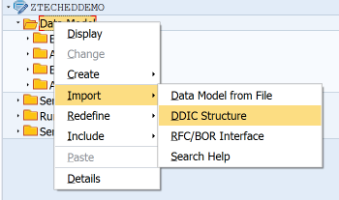
Bind Entity to DDIC Structure

Slide 27
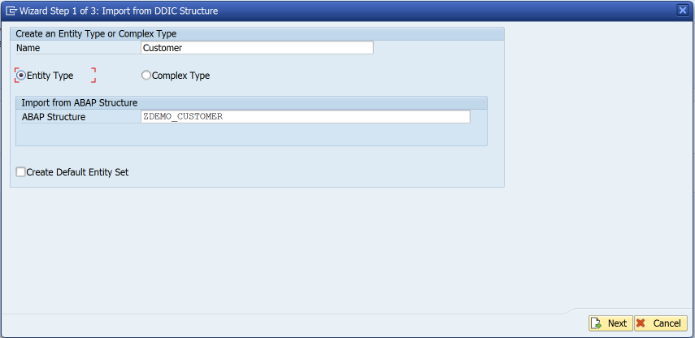
Bind Entity to DDIC Structure

Slide 28
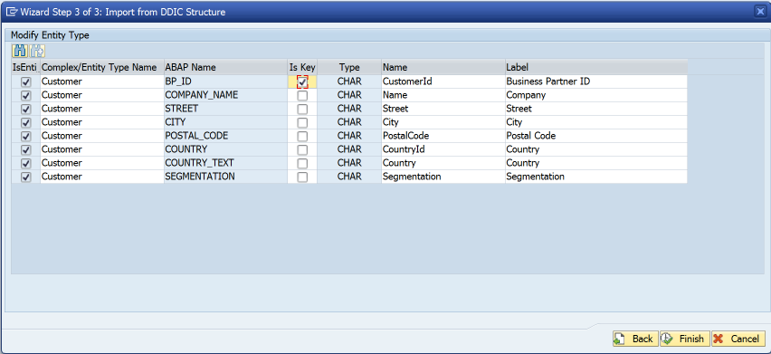
Bind Entity to DDIC Structure

Slide 29
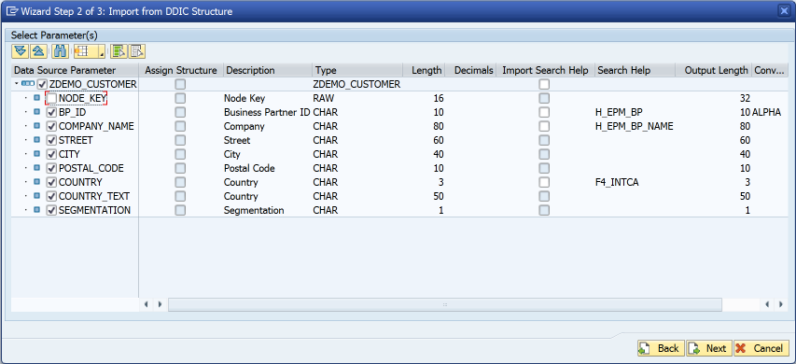
Bind Entity to DDIC Structure

Slide 30
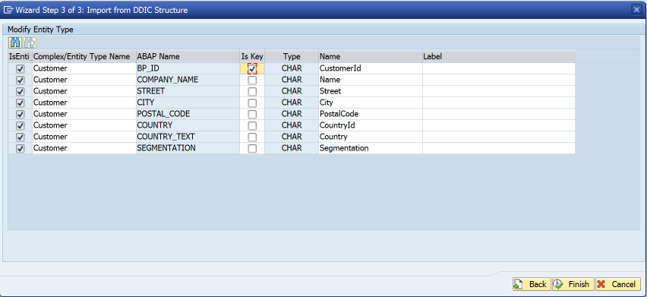
Bind Entity to DDIC Structure
Remove label suggestions
This means labels are determined at runtime rather than design-time

Slide 31
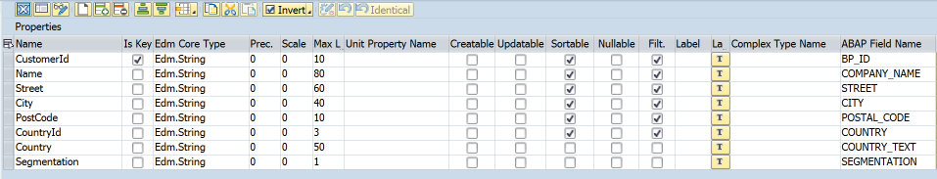
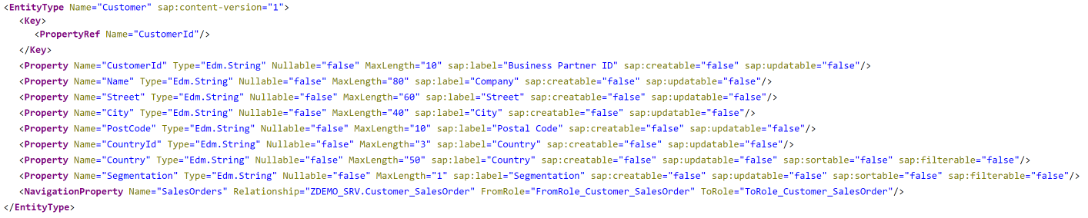
$metadata

Slide 32
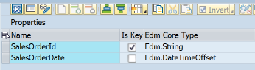
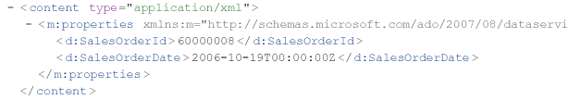
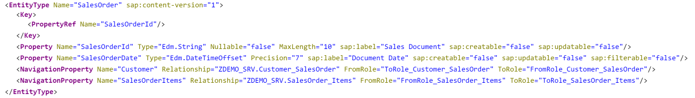
Dates & Times
Use Edm.DateTimeOffset for date/time/timestamp properties
Don’t be tempted to use Edm.String “for convenience”
Edm.DateTime replaced in oData V4 specification

Slide 33
Agenda
Some Warnings
CDS
Service Design
Code patterns for reusability

Slide 34
Code patterns for Reusability
The first rule of reusability is encapsulate all business logic in concrete classes

Slide 35
What a class is not
An ABAP class that only contains static methods is not really a class…..
… in all respects except object type it is a...
Function Group

Slide 36
Code patterns for Reusability
The second rule of reusability ENCAPSULATE ALL BUSINESS LOGIC IN CONCRETE CLASSES

Slide 37
Code patterns for reusability
I like the singleton design pattern in ABAP
Be aware that some people don’t
I don’t care – it works for me
I like getters (& sometimes setters) i.e. Accessors & Mutators
Be aware that some people don’t
I don’t care – it works for me
You can implement business logic however you like… just remember the first & second rules of reusability

Slide 38
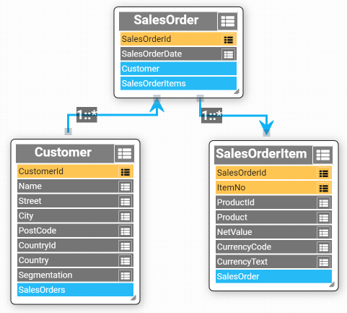
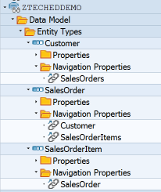
Sample Data Model
Based upon SAP Enterprise Procurement Model

Slide 39
Data Provider Class
DPC
Class

Slide 40
Multiple consumers
DPC
DPC
DPC
Class

Slide 41
Multiple consumers
DPC
DPC
DPC
Common Interface
Class

Slide 42
Replicate GW Method Interface

Slide 43
Avoid Using Deprecated Parameters
https://blogs.sap.com/2017/02/01/avoid-using-deprecated-sap-gateway-apis-in-your-odata-service-implementation/
Nabi Zamani

Slide 44
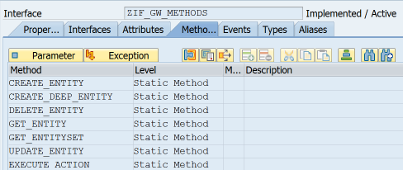
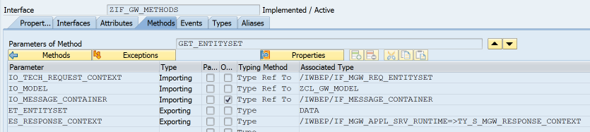
Common Interface
Model
Message Container
Untyped data object

Slide 45
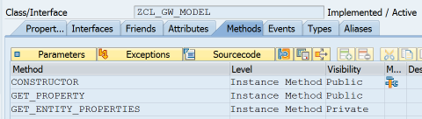
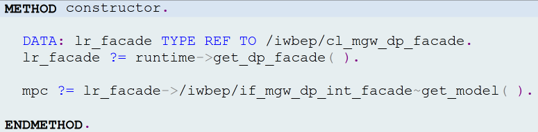
ZCL_GW_MODEL

Slide 46
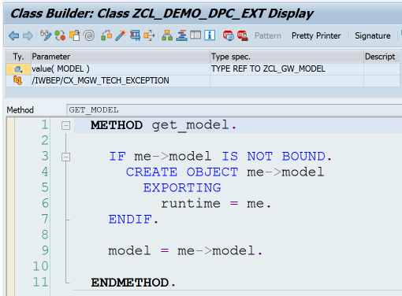
DPC->GET_MODEL

Slide 47
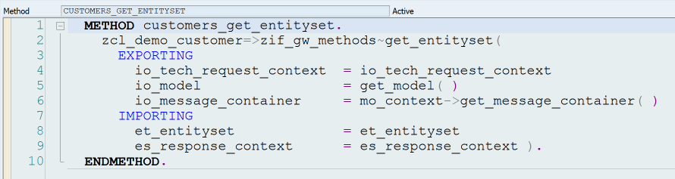
Call BO Class from DPC

Slide 48
oData Operations
 | Identify Primary Key(s) | Instantiate Class | Call class methods | Fill Entity
Create
Read
Update
Delete

Slide 49
GET_ENTITY
Identify primary key(s)
Instantiate BO class
Fill entity

Slide 50
GET_ENTITY V1
DATA: lt_keys TYPE /iwbep/t_mgw_tech_pairs, ls_key LIKE LINE OF lt_keys, lv_bp_id TYPE snwd_partner_id, lo_customer TYPE REF TO zif_demo_customer, lr_entity TYPE REF TO data. lt_keys = io_tech_request_context->get_keys( ). “ Identify Primary Key(s) READ TABLE lt_keys WITH KEY name = 'BP_ID' INTO ls_key. lv_bp_id = ls_key-value. lo_customer = zcl_demo_customer=>get_using_bp_id( lv_bp_id ). “ Instantiate BO Class GET REFERENCE OF er_entity INTO lr_entity. “ Fill entity lo_customer->zif_gw_methods~map_to_entity( EXPORTING entity = lr_entity entity_name = io_tech_request_context->get_entity_type_name( ) model = io_model ).

Slide 51
GET_ENTITY V2
lt_keys = io_tech_request_context->get_keys( ). READ TABLE lt_keys WITH KEY name = 'BP_ID' INTO ls_key. lv_bp_id = ls_key-value. lo_customer = zcl_demo_customer=>get_using_bp_id( lv_bp_id ). GET REFERENCE OF er_entity INTO lr_entity. lo_customer->zif_gw_methods~map_to_entity( EXPORTING entity = lr_entity entity_name = io_tech_request_context->get_entity_type_name( ) model = io_model ).

Slide 52
GET_ENTITY V2 – Table Expression
lt_keys = io_tech_request_context->get_keys( ). * READ TABLE lt_keys * WITH KEY name = 'BP_ID' * INTO ls_key. lv_bp_id = lt_keys[ name = ’BP_ID’ ]-value. lo_customer = zcl_demo_customer=>get_using_bp_id( lv_bp_id ). GET REFERENCE OF er_entity INTO lr_entity. lo_customer->zif_gw_methods~map_to_entity( EXPORTING entity = lr_entity entity_name = io_tech_request_context->get_entity_type_name( ) model = io_model ).

Slide 53
GET_ENTITY V2 – Table Expression
lt_keys = io_tech_request_context->get_keys( ). lv_bp_id = lt_keys[ name = ’BP_ID’ ]-value. lo_customer = zcl_demo_customer=>get_using_bp_id( lv_bp_id ). GET REFERENCE OF er_entity INTO lr_entity. lo_customer->zif_gw_methods~map_to_entity( EXPORTING entity = lr_entity entity_name = io_tech_request_context->get_entity_type_name( ) model = io_model ).

Slide 54
GET_ENTITY V2 – Conversion Operator
lt_keys = io_tech_request_context->get_keys( ). * lv_bp_id = lt_keys[ name = ’BP_ID’ ]-value. lo_customer = zcl_demo_customer=>get_using_bp_id(
CONV #( lt_keys[ name = ‘BP_ID’ ]-value ) ). GET REFERENCE OF er_entity INTO lr_entity. lo_customer->zif_gw_methods~map_to_entity( EXPORTING entity = lr_entity entity_name = io_tech_request_context->get_entity_type_name( ) model = io_model ).

Slide 55
GET_ENTITY V2 – Conversion Operator
lt_keys = io_tech_request_context->get_keys( ). lo_customer = zcl_demo_customer=>get_using_bp_id(
CONV #( lt_keys[ name = ‘BP_ID’ ]-value ) ). GET REFERENCE OF er_entity INTO lr_entity. lo_customer->zif_gw_methods~map_to_entity( EXPORTING entity = lr_entity entity_name = io_tech_request_context->get_entity_type_name( ) model = io_model ).

Slide 56
GET_ENTITY V2 – Reference Operator
lt_keys = io_tech_request_context->get_keys( ). lo_customer = zcl_demo_customer=>get_using_bp_id(
CONV #( lt_keys[ name = ‘BP_ID’ ]-value ) ). * GET REFERENCE OF er_entity INTO lr_entity. lo_customer->zif_gw_methods~map_to_entity( EXPORTING entity = REF #( er_entity ) entity_name = io_tech_request_context->get_entity_type_name( ) model = io_model ).

Slide 57
GET_ENTITY V2 – Method Chaining
DATA(keys) = io_tech_request_context->get_keys( ). zcl_demo_customer=>get_using_bp_id(
CONV #( keys[ name = ‘BP_ID’ ]-value )
)->zif_gw_methods~map_to_entity( EXPORTING entity = REF #( er_entity ) entity_name = io_tech_request_context->get_entity_type_name( ) model = io_model ).

Slide 58
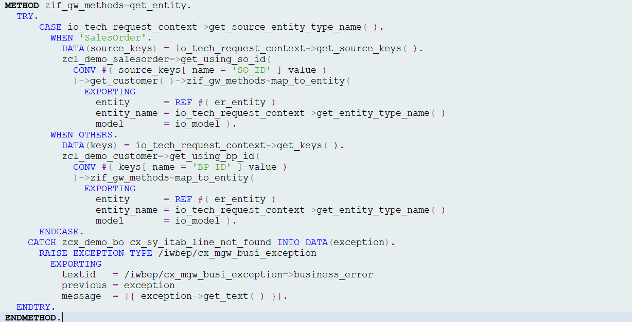
zif_gw_methods~get_entity

Slide 59
zif_gw_methods~get_entity
Use salesorder key to get customer

Slide 60
zif_gw_methods~get_entity
Exception handling

Slide 61
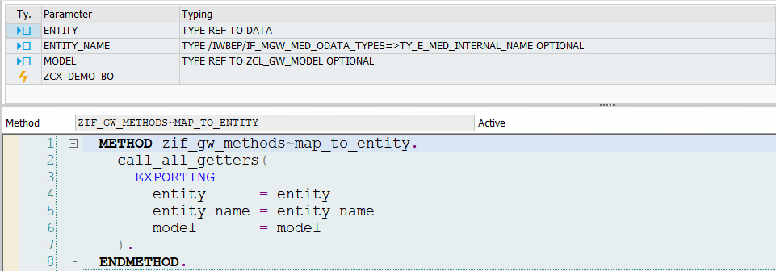

map_to_entity

Slide 62
map_to_entity

Slide 63
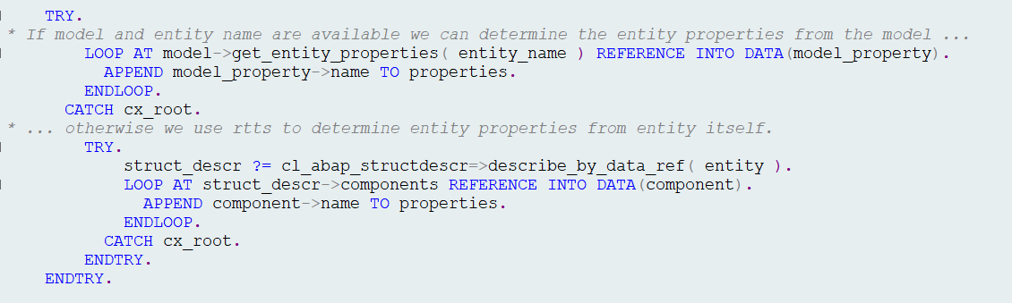
call_all_getters

Slide 64
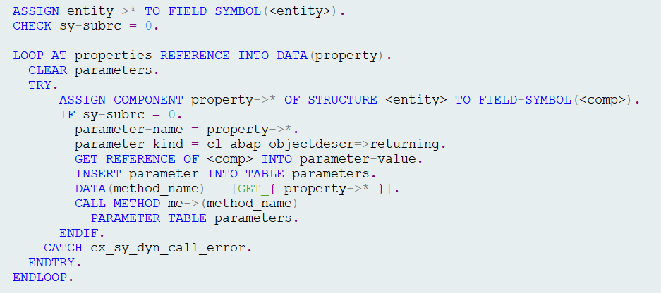
call_all_getters
For each entity component we attempt
to call matching getter functional method
e.g <entity>-prop1 = me->get_prop1( ).

Slide 65
GET_ENTITYSET
Just like GET_ENTITY in a loop…except…

Slide 66
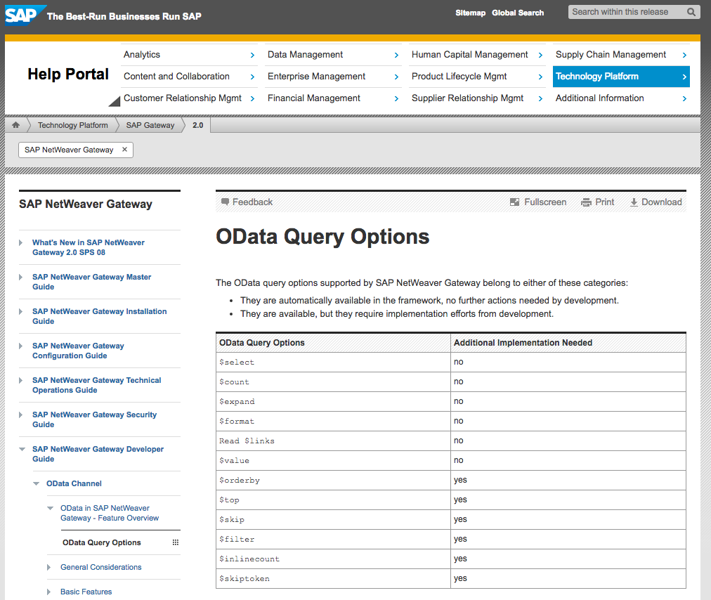
oData Query Options

Slide 67
oData Query Options

Slide 68
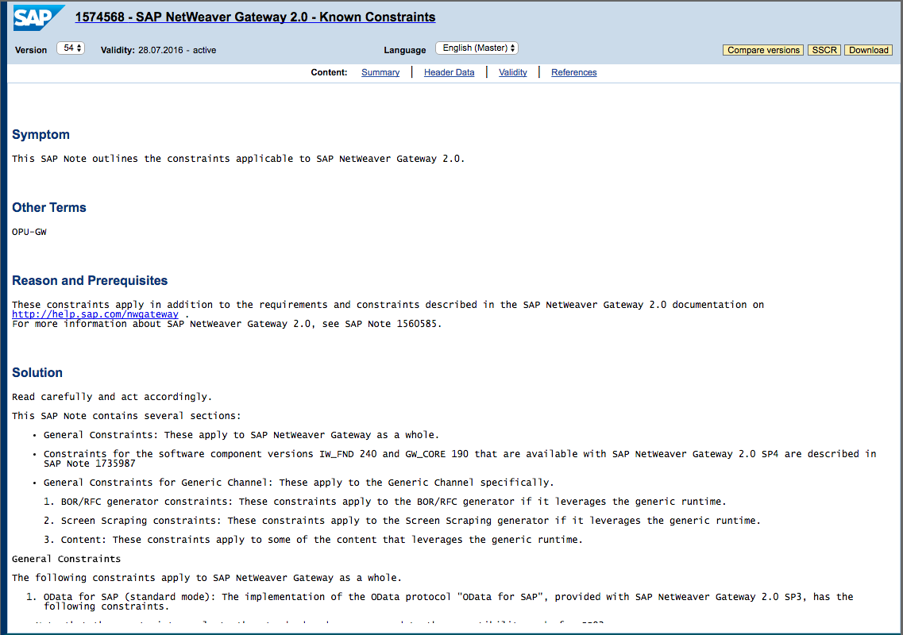
Known Constraints
SAP Note 1574568

Slide 69
zif_gw_methods~get_entityset
Goal is to identify primary key(s) as quickly as possible and use them to fill entities.

Slide 70
zif_gw_methods~get_entityset
Create anonymous data object
$orderby
$filter
$inlinecount
$top & $skip
$count
$skiptoken
Fill entities

Slide 71
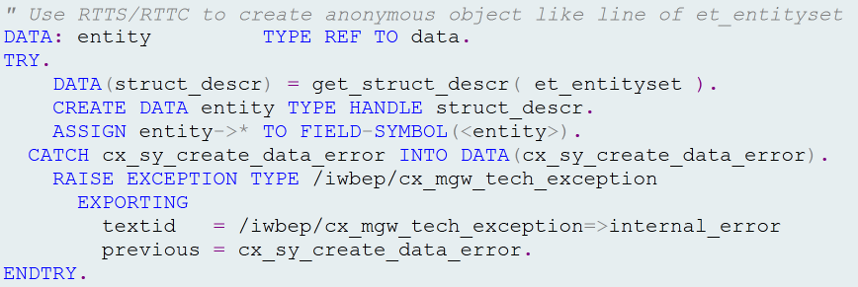
Create Anonymous data Object

Slide 72
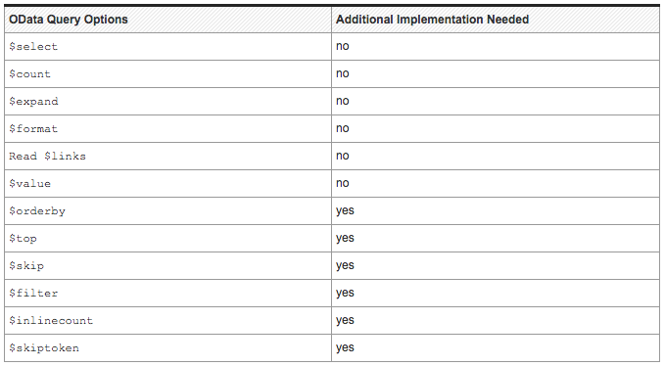
$orderby

Slide 73
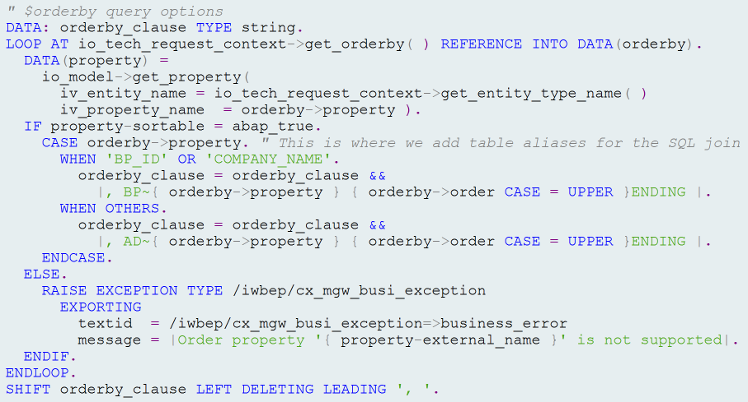
$orderby

Slide 74
$filter

Slide 75
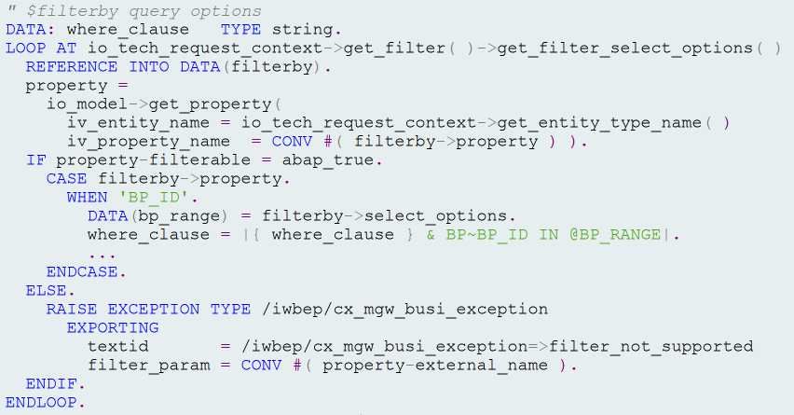
$filter

Slide 76
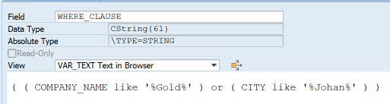
Complex $filter Queries
$filter=substringof(‘Gold’,Name) or substringof(‘Johan’,City)
*Note where_clause may require modification e.g. Table aliases, etc.

Slide 77
$Inlinecount

Slide 78

$inlinecount

Slide 79
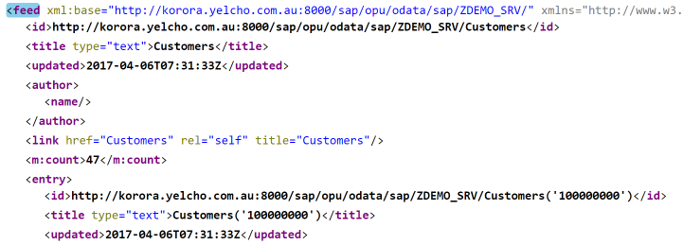
$inlinecount

Slide 80
$top & $skip

Slide 81
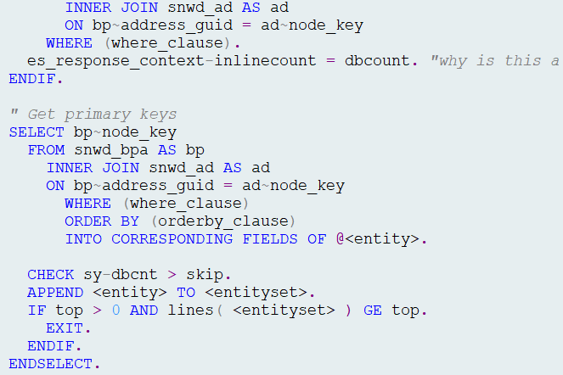


$top & $skip

Slide 82
$count

Slide 83
$count

Slide 84
$skiptoken

Slide 85

$skiptoken

Slide 86

$skiptoken

Slide 87

Fill Entities

Slide 88
Where is the code?
https://grahamrobbo.github.io/building_gateway_services/
To install you will also need abapGit
https://abapGit.org

Slide 89
Summary
CDS
Service Design
Design for consumers
Code patterns for reusability
The first & second rule

Slide 90
Where is the code?
https://grahamrobbo.github.io/building_gateway_services/
To install you will also need abapGit
https://abapGit.org

Slide 91


@grahamrobbo
@jasper_07
Photo by Frank Hurley – used with permission

